Slide 1
Marketing Planning and Execution
Process Overview and Maps
October 2007

Slide 2
MP&E Process Overview
Marketing Planning and Execution (MP&E) is the process used by US Decision Science, LMR, and Lilly USA Sales and Marketing to reconcile spend levels across marketing channels and key player segments for all products as well as portfolio of products.
The analytical framework of the MP&E process is called Promotion Mix Architecture (PMA). The key output of PMA are incremental revenue and contribution curves by brand, key player segment, marketing channel, and, possibly, message type.
In addition to the marketing plan and resource allocation, the incremental revenue and contribution curves are also used by Sales for Call Plan development and physician Targeting, by LMR Forecasting for the development of sales Forecast, and by Marketing for the development of Message Content.
MP&E complements and augments existing marketing effectiveness metrics such as brand equity and preference/loyalty studies. Some of the main questions it addresses are:
• What is the ROI by brand, by channel, by KPS? How has it changed over time?
• What might be the key drivers of ROI?
• How can this information be used to help improve marketing planning and execution?
• How much of our business is due to promotional activities?
• What has carryover been, by KPS?
• What has the historic reach and frequency been?

Slide 3
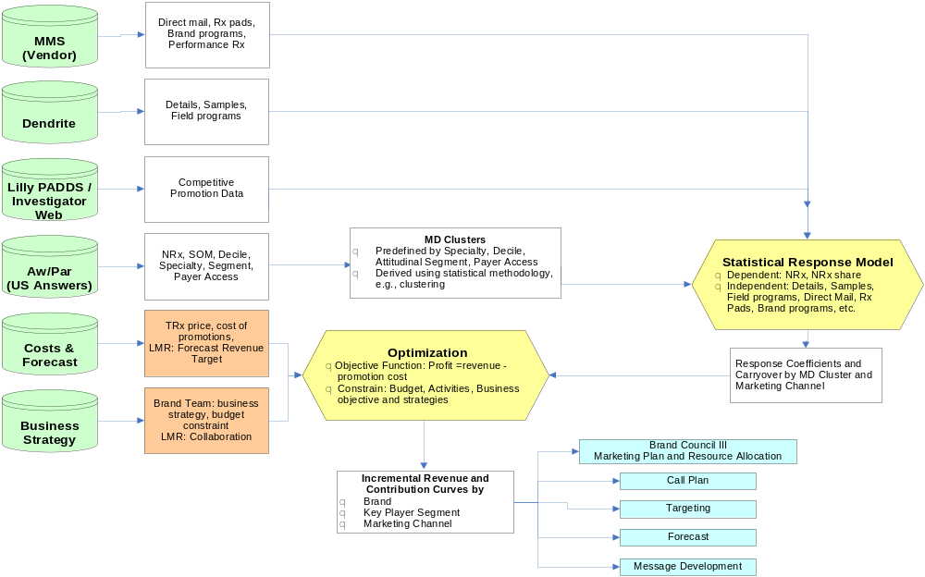
MP&E Process Map

Slide 4
MP&E Analytical Framework:
Promotion Mix Architecture
Promotion Mix Architecture is a two step process:
  A. Statistical Response Model: Find the relationship between marketing interventions and incremental revenue
  B. Optimization: Use these relationships to determine the impact of future spend
Primary Limitations of Promotion Mix Architecture
  Estimations are based on historical data
  Historical data is richer for certain interventions compared to others
    Much more data available on details compared to programs/DTP
  Not all promotional channels are modeled within the marketing mix modeling framework
    For example: Certain intervention types like B2B, payer are currently not within the mix modeling framework
Considerations when interpreting the models for marketing planning
  Intent of models is to provide additional information/insights to help with the decision making process
  It is NOT the intent of models to provide “the” answer or replace business judgment

Slide 5
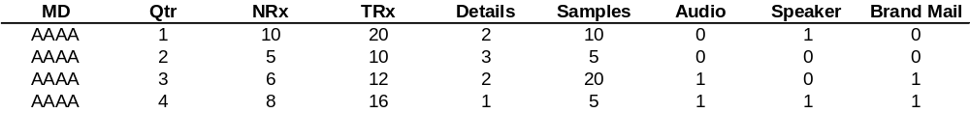
Promotion Mix Architecture
Conceptual illustration
Time series data on MDs
12 months of data for KPS physicians
Statistical Response Model
Conceptually like regression but incorporates
  Correlations of MD behavior over time
  Takes into account MD prescription volatility
  Incorporates hierarchy in terms of MD segments
Widely used in Consumer packaged goods, Travel and Pharma industries
Optimization
Non-linear programming techniques used to make trade-offs across channels
x
x
x
x
x
x
x
x
x
Inc NRx
x
x
x
x
Inc $
x
x
Convert Inc NRx to Inc $ using refill, price
Convert activity to cost using cost per activity
x
Details
Details Cost ($)

Slide 6
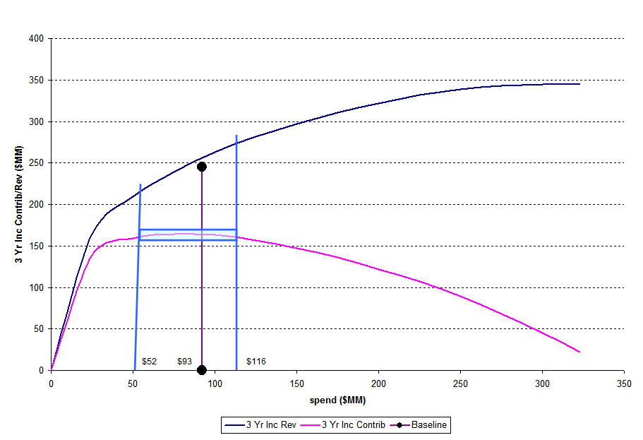
Incremental Revenue and Contribution
Response Curves – How to interpret
Area of roughly equal contribution
Current OPEX allocation results in 90+% efficiency
Under
investment
overinvestment

Slide 7
Linkage between MP&E and Targeting Process
MPE Process Parts
(Relevant to targeting)
Targeting Process
(High level view)
Brand Key Player Segment
Identification
Valuation/Prioritization
Targeting Strategy
Translate brand strategy into actionable recommendation for sales force
Output is prioritization/tiering of MDs with calls goals per tier
Incremental
Revenue/Contribution Curve
Specific to details/Samples
For each key player segment
Targeting Implementation
Communication of targeting strategy to the field
Sending out MD level lists by territory to the field
The key link between MPE and targeting process is the feeding of brand strategy in terms of key player segments, and historical response model/valuation of MD groups into the targeting strategy step of the targeting process
Targeting Assessment
Measures the gap between recommended targeting plan and actual implmentation

Slide 8
Linkage between MP&E and Call Plan Process
MPE Process input to Call Plan Process
Forecasting input to Call Plan Process
Incremental
Revenue/Contribution Curve
Specific to details/Samples
3 Yr Inc Rev/Contribution based on 1 year detailing effort
Inputs from forecasting for 12 quarters
Market/Product TRx forecast
Price Forecast
Get detail response curve by quarter for 12 quarters
Share responsiveness
Inc Revenue Curve
Inc Contribution Curve
Determine number of sleeves/Sleeve size
Products carried by each sleeve
Incentive weight of products in a sleeve
Scenario analysis that compares share/revenue/contribution impact across scenarios
Call Plan Process

Slide 9
Linkage between MP&E and Forecasting Process
Promotion Mix Architecture
Incremental Revenue Estimate
Lilly Indications
Dave Brown’s Forecasting Models
Competitor Indications
SOM Trends
Brand Forecast
Market Value Trends
Pricing
Management

